Slide 1
A Look Back at Our Provider Spotlight's

Slide 2
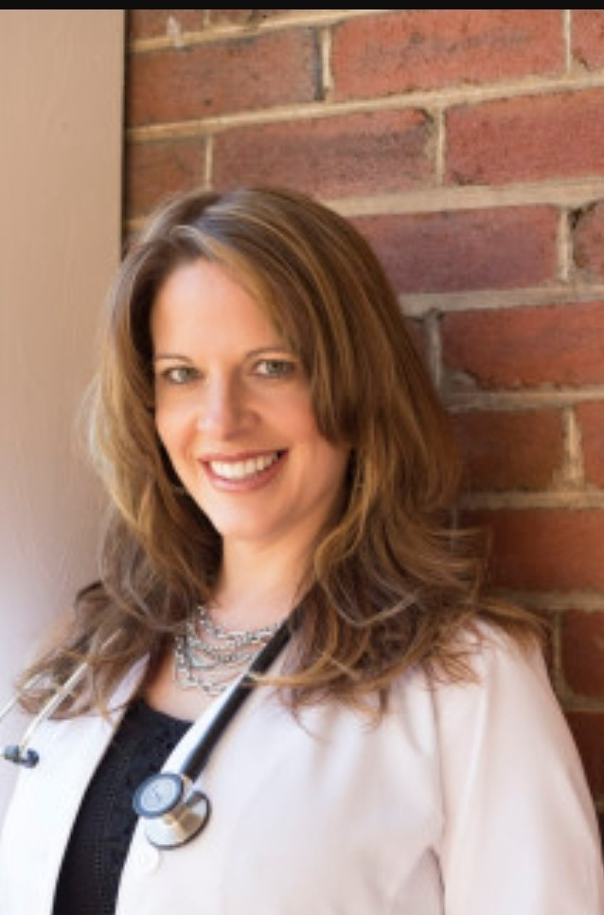
June/July 2022
Leigh Brooks, MSN, APRN, FNP-C
A Family Nurse Practitioner at Bluestone Primary Care in Princeton, WV. She is the Medical Director for the Office Based Medication Assisted Treatment (OBMAT) Program for opioid use disorder at Bluestone. She participated in the March 2020 WHAMP training and has since treated her own OBMAT patients and patients that are referred to her from other providers. She provides OBMAT services and HCV treatment within primary care setting where she is able to develop a strong rapport with her OBMAT patients to meet their other healthcare needs. Leigh has submitted the most consults and achieved the most cures in the WVHAMP program with 224 of the 593 initial consults and cured 124 so far for a 97.6% cure rate.

Slide 3
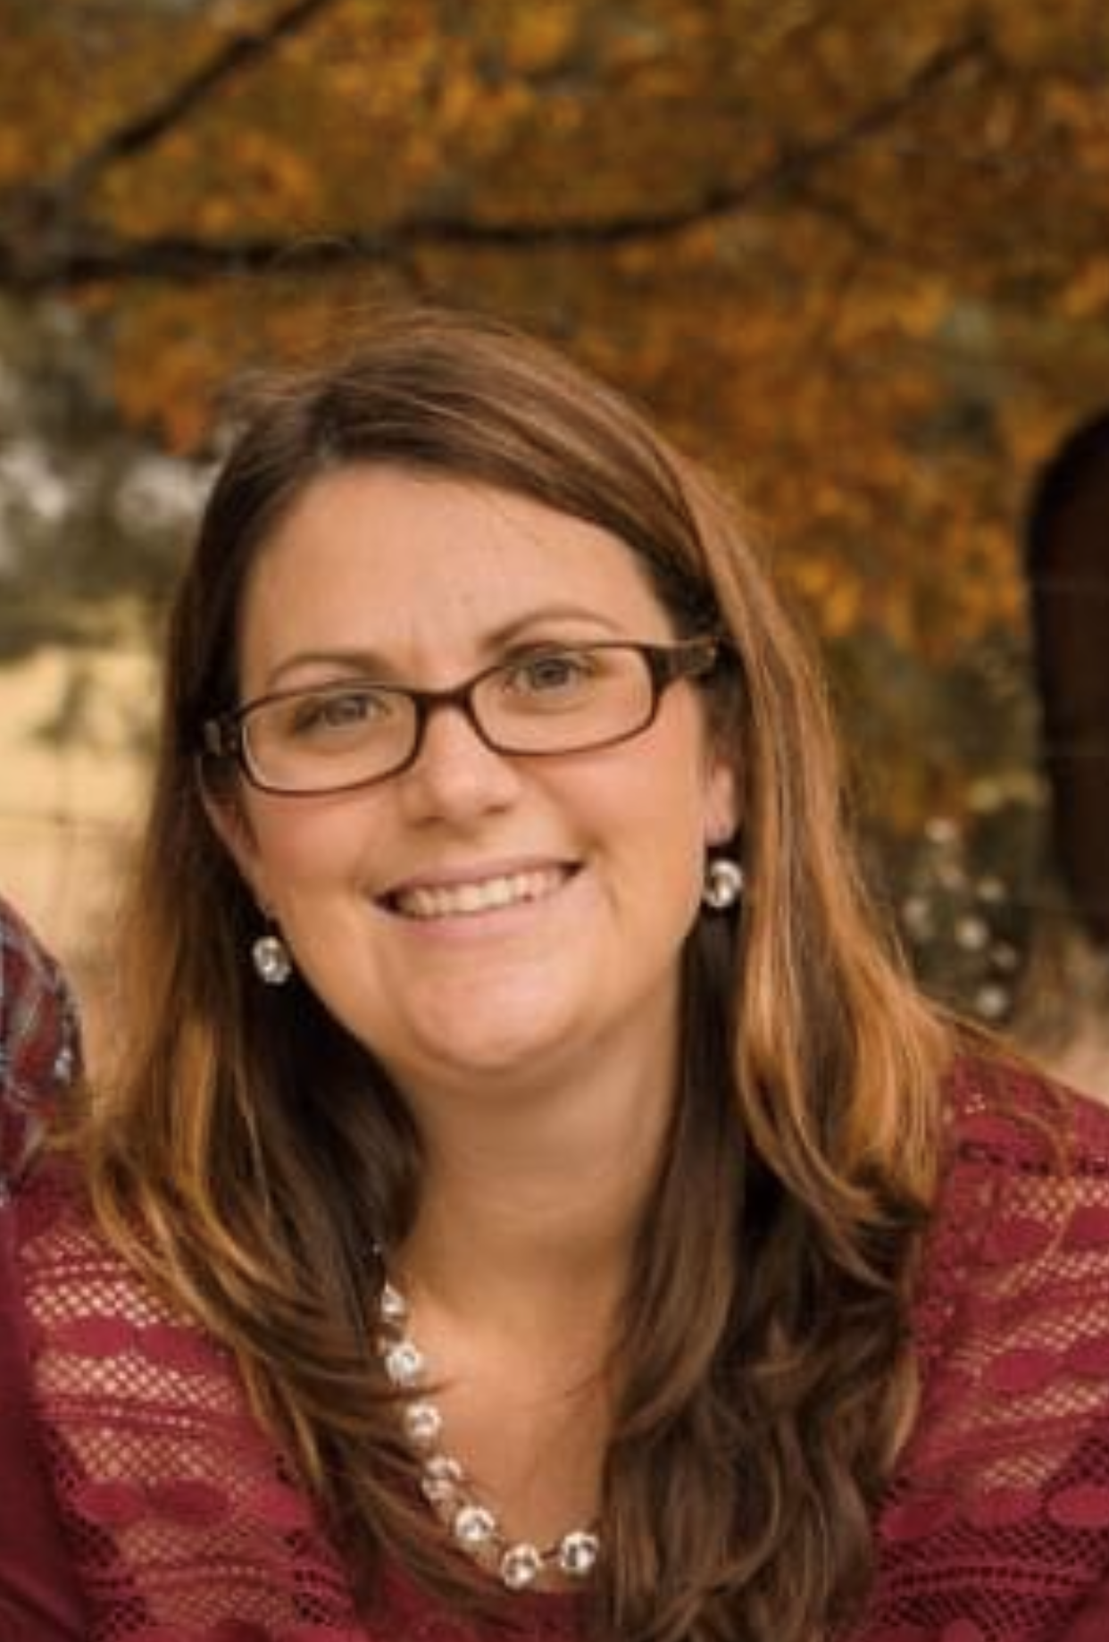
August 2022
Samantha Nunley, FNP
“There is a great need for treatment, and I feel blessed to be a part of it.”
A Family Nurse Practitioner at Bluestone Primary Care in Princeton, WV, she has been with the clinic for 17 years. She began as an LPN working her way up to an RN then became an NP in 2015. For the past 7 years she has worked in family practice and enjoys treating the Hep C patients. She participated in the very first WVHAMP training on March 5, 2020, and has since not only treated a lot of her own patients but has also received referrals from other providers. Samantha has the second highest number of consults in the WVHAMP program with 53 out of the 628 initial consults and 16 cured so far for a 94.1% cure rate; 16 of these 53 consults have been referrals (30.2%), evidence that she is seen as an expert resource in her community.

Slide 4
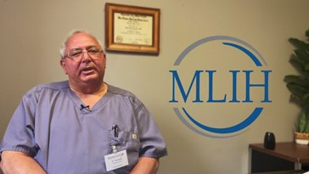
September 2022
Raymond Rushden, MD
In my 36 years of medical practice in Logan and Mingo counties, I frequently noted the number of patients I was discharging from the hospital with mental health problems, that had nowhere to be referred for mental health issues whether it be depression, anxiety, schizophrenia or drug and alcohol addiction. Any referrals to other counties ended up being canceled or no shows. Their problems were not addressed, and therefore mental health issues flourished and worsened. Until recently it was 6 months before that patient could be seen locally.
As I was evaluating MAT patients, I found a high percentage positive for HCV. We decided to help these people with my background in GI. I joined WVHAMP and was well schooled by Dr Feinberg and others. I’ve evaluated 57 patients until now and have 40 cures. They probably would never have been treated except for WVHAMP.
When I began as staff physician at Logan Mingo Area Mental Health (LMAMH) 8+ years ago, I was the only local provider for the area except for a doctor on telehealth for some of the Mingo County consumers. Working 12 hours/day, 6 days/week we were able to try to catch up on those who had lost their appointments from the previous single provider. I see my role at LMAMH as trying to assist the community with their mental health concerns now that there are nurse practitioners on staff. I plan to direct the plan of patient care with all providers, as this community must have a local answer for general psychiatry problems as well as the ever-increasing load of patients suffering from substance use disorder; at least for the portion of them seeking our help or being referred from the ER, local physicians’ offices, and law enforcement. And now we can add curing HCV to our list of accomplishments.
Dr. Rushden participated in the first (and only) in-person WVHAMP training in March 2020 and 13 of his patients who have reached the timepoint for assessment of response have all been cured, 100% cure rate. With WVHAMP support he has treated complex patients who previously would have been referred to specialists in Charleston. The 57 consultants he has submitted so far, 38 have been referrals, evidence that he is seen as an expert resource in his community.

Slide 5
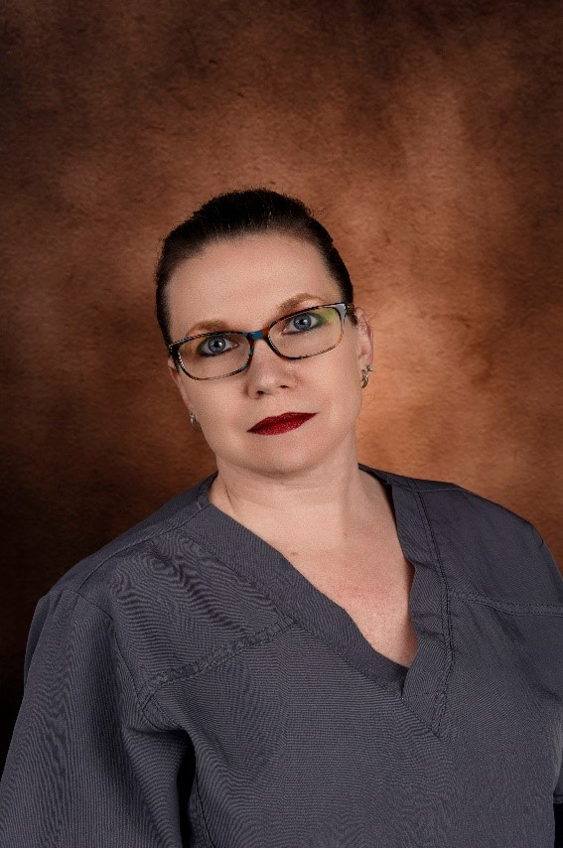
November 2022
My name is Miranda Boso. I am originally from Greeneville, Tennessee. I graduated with my BSN from East Tennessee State University in 2000. I moved to Belpre, Ohio in 2002 after I married. I have worked in orthopedics, urology, pediatrics, and urgent care during my nursing career before I graduated from Ohio University as a nurse practitioner in 2015. I have worked for Coplin Health Systems since 2015. My Coplin office is located within Westbrook Health Systems. Westbrook provides mental health and substance use treatment. I provide primary care as well as the benefit of treating Hepatitis C and soon, hopefully, HIV.
I have personal reasons for treating Hepatitis C. I use both as examples when I talk to my patients. One is Hepatitis C related; one is not. My stepmother was diagnosed with Hepatitis C after receiving a blood transfusion prior to 1993. She ultimately received a liver transplant as a result. That was almost 30 years ago.
My long-time friend of 12 years, and father of my godson, Kelley, did not have Hepatitis C, but he was an active heroin user who died with his third overdose. Kelley used intravenous heroin; he started with using oral pain medication. We never knew about his addiction until he was heavy into heroin use, probably the last two to three years. He lived across the street from us when I moved to Belpre in 2002. He was a black belt in martial arts, starting at the age of 4, a typical high school student, a skater kid, and he was like my little brother. He was sensei to my son and daughter and drove them to many tournaments (unbeknownst to me, he was probably under the influence of pain medication). Kelley died when my godson was 2 months old (his son will be eight this year). It was then that I realized how close substance use disorder was to my family/children, my neighborhood, and how devastating it was to those I loved and how blind I had been. I feel that through my relationship with Kelley, I learned many things, especially towards the end. To begin, I am not as naive, but I also do not judge. I tell my patients on day one that they are not just a patient, they are a person and will be treated as such. You should see how much relief washes over their face by just being recognized as a person and not an addict. I also am non-judgmental and transparent with my patients. I tell them about Kelley. I congratulate them on seeking treatment and are glad that they are here seeking healthcare, and that no matter what they did, my office/exam room is a judge-free zone. If they relapse, I will not judge, they can still see me regardless. We will discuss it, I can point them in the right direction for treatment if they choose, but I will still ensure they are healthy.
With WVHAMP support, I have treated 45 individuals, and so far, 24 who have reached the timepoint for evaluating cure have achieved it. This has been very gratifying to both me and my patients. With one-on-one assistance from WVHAMP, I treated my first patient with HIV who responded within just a couple of weeks. I am looking forward to participating in the upcoming West Virginia HIV Academic Mentoring Program (WVHIV AMP) early next year. Problems are easily fixed. Substance abuse is not a problem- it is a disease. I feel once more perceive it that way, then maybe it will become like mental health and stop receiving a negative stigma but a more proactive approach regarding treatment within communities. Substance use is in every community. It affects everyone because there is not a “type”. Hepatitis C and HIV are in every community, they do not have a “type”. I want to treat these people.
I feel that treating Hepatitis C reinforces one’s sobriety, thus helping not only improve one’s long-term health but helping reduce our substance use problem one person at a time. My patients know that I care and am willing to see them through an important step in their recovery. When my 28-day treatment patient’s find out they have Hepatitis C, they are devastated and depressed. That is why I ask them what their plans are after discharge at their initial visit. If they stay local, I’m like “Hmmm, well guess what I can do for you…” and if they go out of town, I send them with a copy of their labs and refer them to infectious disease to wherever they will be going. Just because they will be out of my care doesn’t mean I stop caring. I love treating hepatitis C, there is not better gift you can give someone than a cure. I also love mentoring others on how to treat hepatitis C.
I had the opportunity, with Dr. Feinberg’s help, to recently treat a patient newly in recovery (7 days?) who had both HIV and Hepatitis B. He knew that I had never treated either but that I was willing to get him the treatment he needed and get him set up with a treatment center after his discharge. With Dr. Feinberg’s help, I started him on Biktarvy, and referred him to a treatment facility recommended by Dr. Feinberg. He had 3 months of his medications waiting on him at his local pharmacy when he was discharged home. The facility had all his labs. It was a great and wonderful hand off. I spoke to him after his discharge, and he is compliant with is treatment and taking his medication every day. HIV is what I look forward to learning how to treat next. I want to do as much as I can to help as many people as I can.

Slide 6
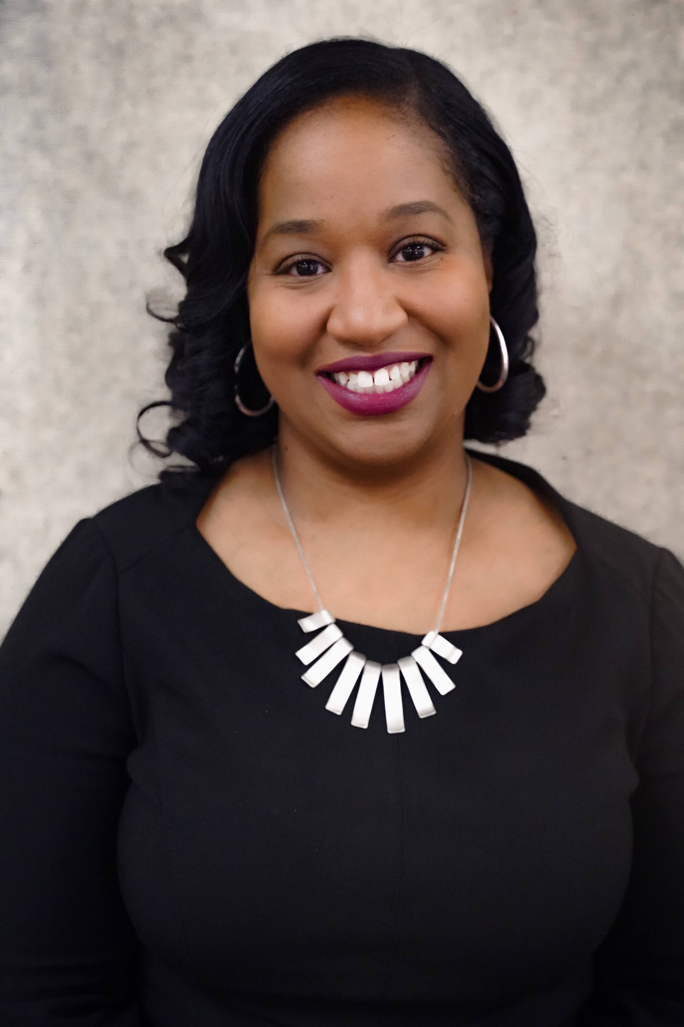
December 2022
My name is Michele Roach-Courts. I am from Charleston, WV. I graduated with my Bachelor of Science in Exercise Physiology from West Virginia University. I then went on to PA school at Alderson Broaddus College, where I obtained another Bachelor of Science in 2003. After practicing for 5 years, I completed my Master of Science in PA Studies from Alderson Broaddus College. I am currently working on my Doctor of Medical Science degree through Lincoln Memorial University.
I have been a practicing physician assistant since 2003 and have worked in primary care, urgent care, and psychiatry. I have worked for Cabin Creek Health Systems at our Kanawha City location since 2014, where I currently practice in primary care, as well as treat Hepatitis C. I am looking forward to also learning how to treat HIV, through the upcoming WV HIV Academic Mentoring Program.
There are very few disease states that can be cured, and not just managed. So, I find it very gratifying to be able to treat these patients and give them some peace of mind when it comes to Hepatitis C. I also think that being able to cure a patient’s Hepatitis C encourages them to maintain sobriety. I was a participant of the first WVHAMP cohort in 2020. With the support of WVHAMP, I have treated over 25 individuals, and half of them have achieved cure. I look forward to treating more.
I believe it’s important to give back to your community, not only through your work, but also with your time. I am currently on the DEI committee of the WV Rural Health Association, a member of the African Heritage PA Caucus, and a proud member of Alpha Kappa Alpha Sorority, Incorporated. In my spare time, I enjoy traveling, trying new restaurants, and spending time with my friends and family.

Slide 7
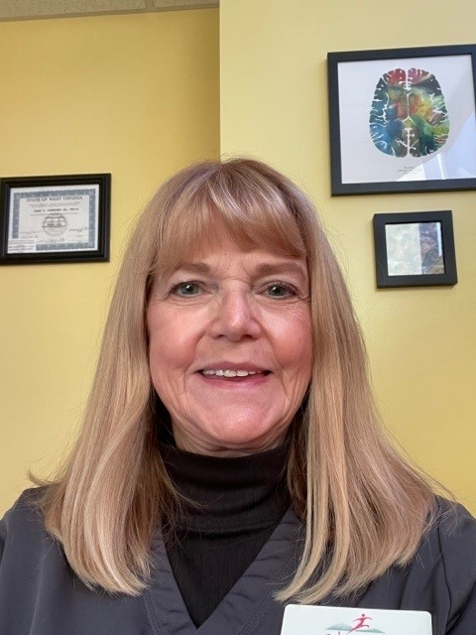
January 2023
My name is Tammy Campbell-Cline. I am a native of West Virginia, and I have always lived in Raleigh County. I graduated from Morris Harvey College in 1978 with an Associate of Arts Degree in Nursing and from WVU in 1981 with a BSN. After working 3 years in med-surg at a local hospital and 4 years for a gastroenterologist, I have worked the remaining years in primary care.
In 1988, I found my home at New River Health, a community health center in Fayette Co. I saw a great need for medical providers and decided to become a nurse practitioner. I obtained by MSN/FNP from WVU in 1996. I worked for a number of years at New River Health and Access Health in Beckley, WV.
I accepted a position at Cabin Creek Health Systems in January 2018. I work in a small clinic inside the Kanawha Charleston Health Department. The clinic was started in an attempt to see folks who came through the Harm Reduction/Syringe Exchange Program. There was a need for primary care services including care for chronic diseases, birth control, treatment for abscesses, sexually transmitted diseases, and other infectious diseases including HIV, Hep B and Hep C. I was shocked at the number of patients who tested positive for hepatitis C.
I had the opportunity to participate in the first WVHAMP training in March 2020. Since then, I have 29 patients that have finished treatment and have been cured, 7 in current treatment, and have at least 5 that are in the process of getting started with treatment. It is so gratifying to see the patients and tell them they no longer have hepatitis C because they have been cured.
Most of the patients I see have contracted hepatitis C through injection drug use. Addiction, a chronic medical disease, is cunning, baffling, and powerful. It is often accompanied with other physical, mental, and social problems. While there are currently so many programs and efforts to treat patients with substance use disorder, there is still so much work to be done.
In addition to working, I have served on the board of Hospice of Southern WV since 2005. I live near Beckley, am married, have two grown sons, three grandchildren, and a rescue dog named Ladybug. I enjoy reading, gardening and have recently been taking painting classes.

Slide 8
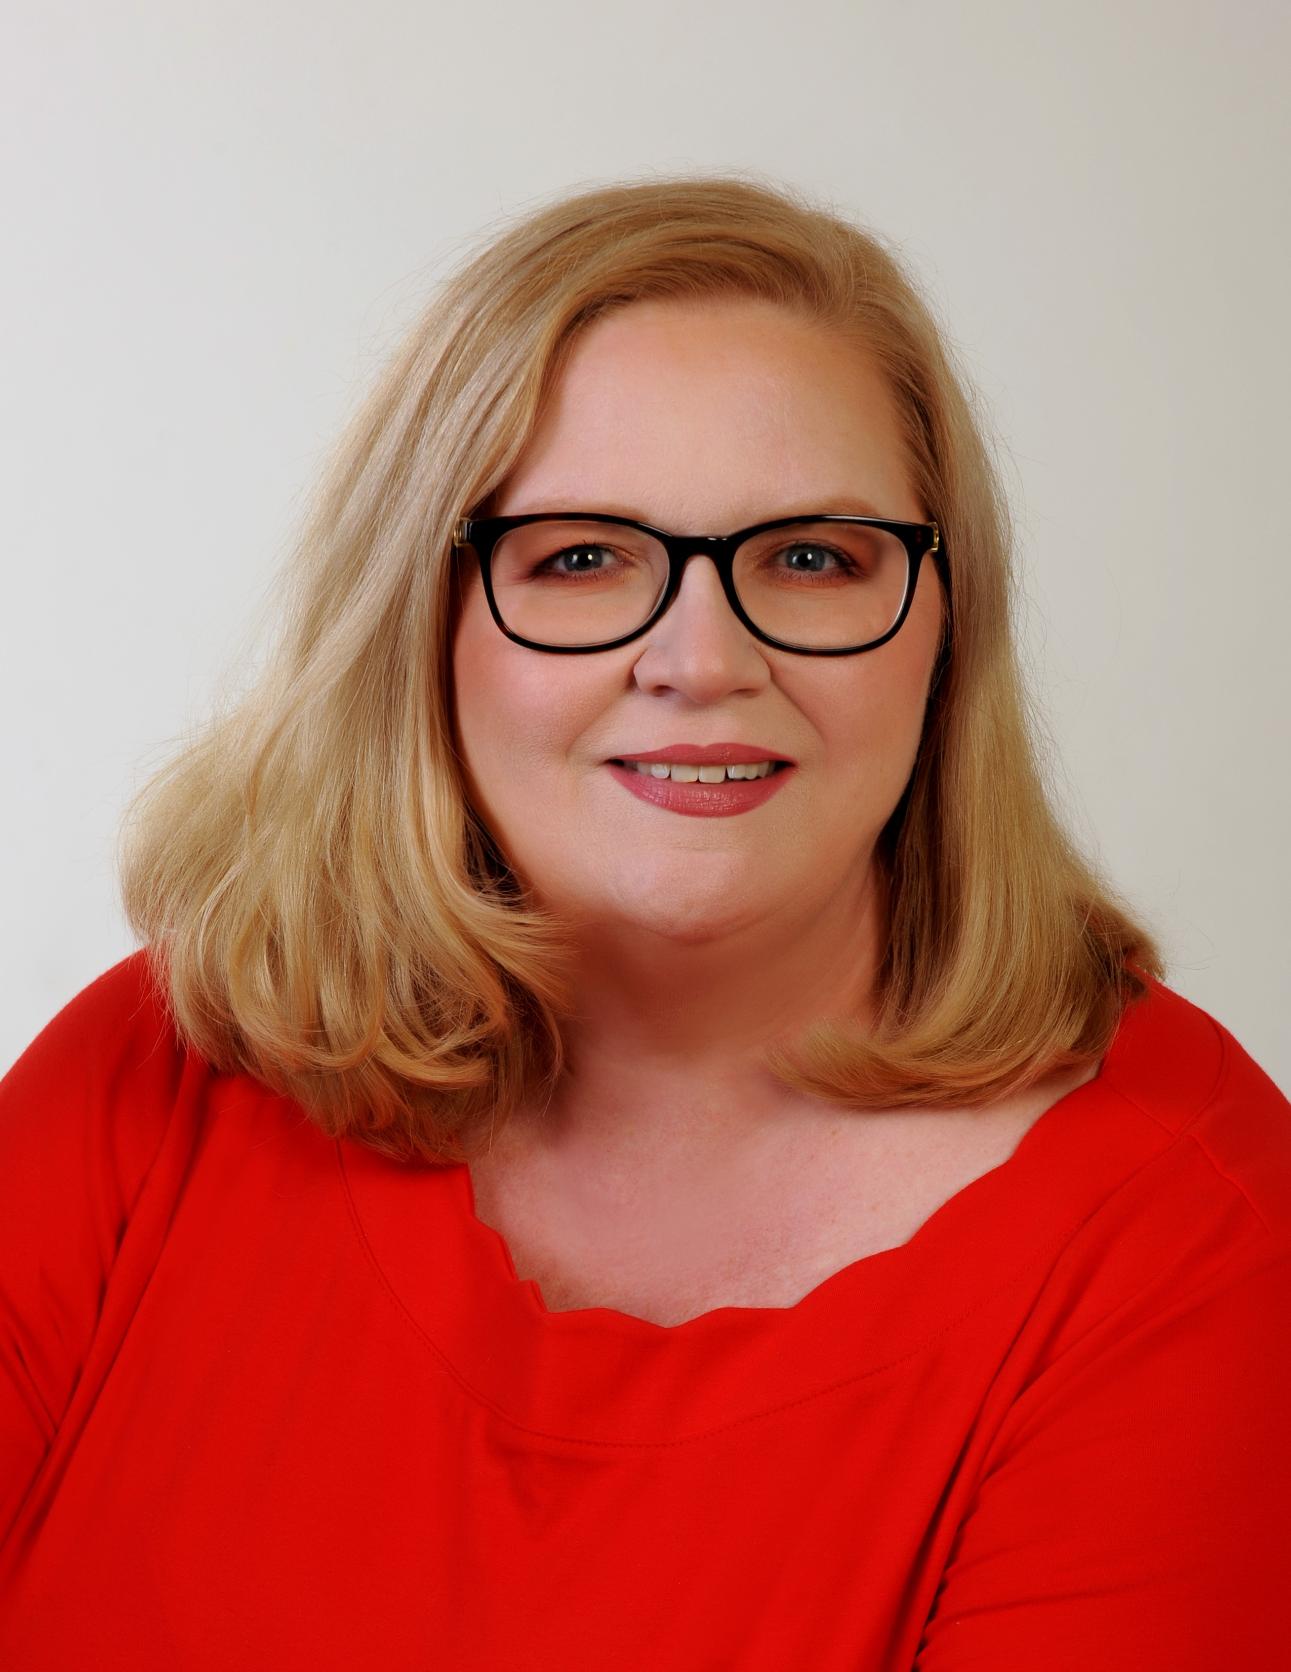
February 2023
I am Dr. Letitia Tierney, an Internal Medicine and Pediatric Physician who currently serves as a Primary Care Physician in Charleston, WV. I am also an Associate Clinical Professor of Medicine at West Virginia University. I received my undergraduate degree and my medical degree from West Virginia University. I also earned a Law Degree from the George Washington University School of Law and a Certificate in Public Health Leadership from the Kennedy School of Public Health at Harvard University. I completed an Internal Medicine/Pediatrics Residency at West Virginia University and Charleston Area Medical Center, serving as Chief Resident in my final year of Residency. I have extensive Public Health experience serving as the Commissioner for the Bureau of Public Health and West Virginia State Health Officer under Governor Earl Ray Tomblin. I was born and raised in Charleston and am glad that I am able to provide health care in Kanawha County. I am also proud of the work we have all done to bring Hepatitis C care to West Virginians and look forward to a future free of Hepatitis C for everyone.

Slide 9
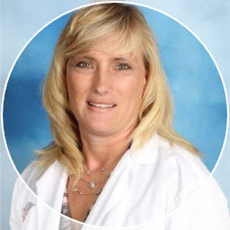
March 2023
I am Dr. Melissa Welch DNP, FNP-BC, and have served as a primary care provider at Shenandoah Community Health Center in Martinsburg, WV for the last 17 years. I have lived in West Virginia for the past 32 years and have been in healthcare since 1994. I am also an active Maryland National Guard member at the 175th Medical Group in Baltimore, Maryland. I received my undergraduate degree at Mountain State University and my doctorate from Shepherd University in West Virginia. I have had extensive public health experience throughout my career. I served as the Director of Congregate Care Service for Maryland Department of Health under Governor Larry Hogan during the COVID-19 State of Emergency pandemic. I currently care for an array of special populations in the Eastern Panhandle and with the National Guard. My most recent endeavor to help the local community has been starting a Hepatitis C Treatment Program and providing a Suboxone Bridge Program in conjunction with the behavioral health unit here at the Community Health Center. I am proud to be a part of a team who has worked hard to bring hepatitis C care to this special population in the great state of West Virginia.

Slide 10
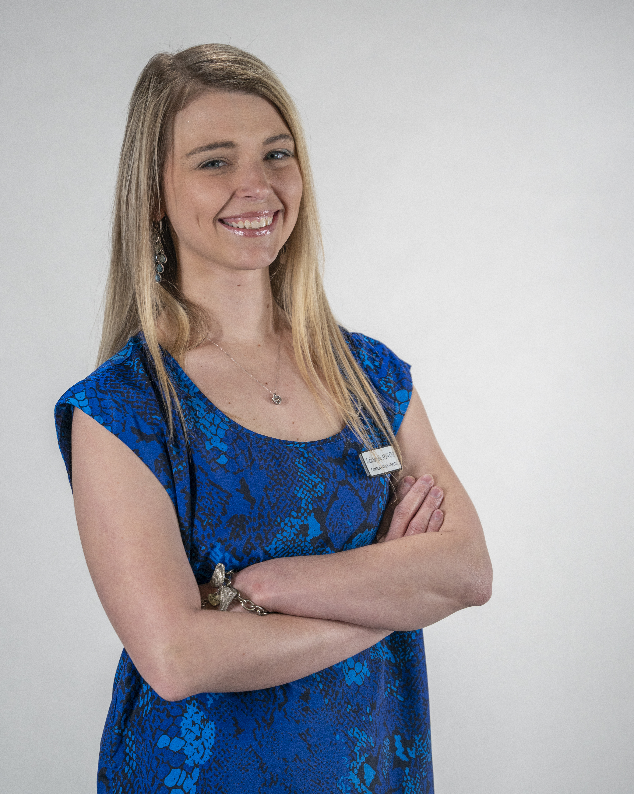
April 2023
My name is Tricia Simpkin, and I am a family nurse practitioner in Summersville, WV. I work for Camden Family Health where I do family practice and hepatitis C treatment. Since I started treating hepatitis C in January of 2022, I have submitted 34 consultations. Of those 34, the patients who have completed treatment and returned for subsequent lab work have all been cured of hepatitis C. The one thing that I truly love about treating hepatitis C is that I get to help cure those patients. Rarely in family practice do we ever get to cure a patient, instead we just help treat and manage chronic conditions. Most of the patients I treat for hepatitis C acquired it from injecting drugs and have completely changed their lives and this is the final step to help them heal and have a happy, healthy life. Patients diagnosed with hepatitis C often come into their initial visit uneasy and worried, because people in our society have belittled them instead of trying to help them. My goal as a provider who treats hepatitis C is not only to cure these patients, but also to encourage them so that they spread the word to others who are afraid of seeking treatment due to judgmental attitudes on the part of people working in healthcare systems. I am honored to be part of WVHAMP and enjoy going through the process with each patient.

Slide 11
May 2023
My name is Daonna Martin, and I am a family nurse practitioner in Rainelle, WV. I work for Rainelle Medical Center. I became a member of the WVHAMP program in late 2021. Since then, I have submitted 31 hepatitis C treatment consultations. All the hepatitis C patients that have completed the medications and necessary lab work for the program have been cured of hepatitis C. I am so thankful that patients with hepatitis C are able to receive the care that they need closer to home through WVHAMP. I enjoy treating hepatitis c because I can change a patient’s trajectory from liver failure or possible hepatocellular cancer to completely removing a major risk factor for those ailments, and I find that to be one of the most satisfying things in medicine.

Slide 12
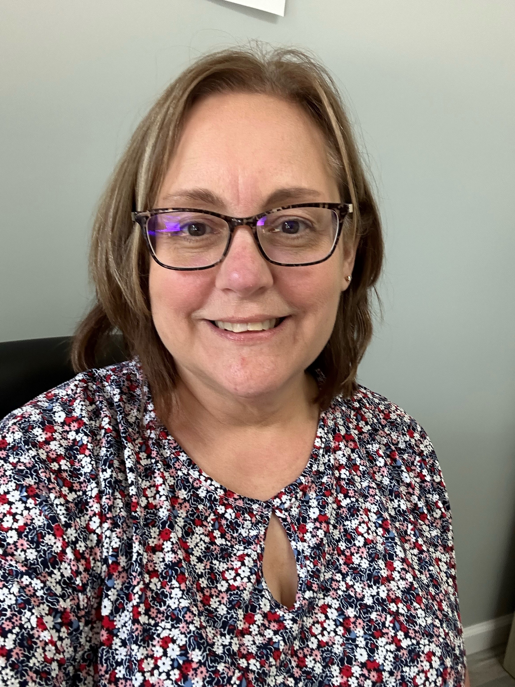
June 2023
My Name is Melissa Maston, I am a Family Nurse Practitioner in Wetzel County. I currently work in a Behavioral Health clinic that I co-own with another NP. I have been a practicing NP for almost 10 years, and this is by far the most rewarding position I have had. We opened in September 2021. We focus on MAT treatment and have been treating Hepatitis C through the WVHAMP program since 9/14/2022. I am thankful to be able to bring the treatment of Hepatitis C to my small community.

Slide 13
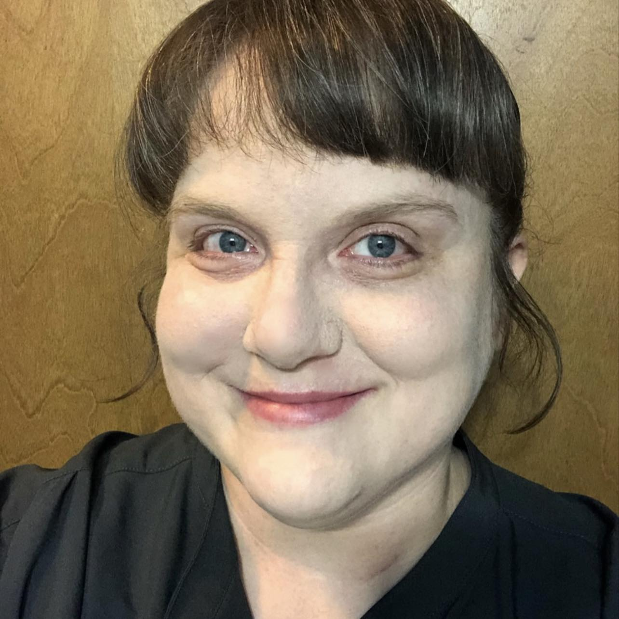
August 2023
Sarah Sprouse, MSN, APRN, FNP-BC, CARN-AP
I practice in Mason County and Putnam County, WV as a family nurse practitioner specializing in addiction medicine. In my personal life and professional life from Texas to West Virginia, I have seen both how addiction can tear families apart and how chronic illness affects one’s ability to function at their optimal level. The valuable training and mentorship that the medical professionals of the West Virginia Hepatitis Academic Mentoring Partnership has provided me, has allowed me to now further my work in addiction medicine by helping patients to regain an aspect of their health that they have long given up on. With the valuable guidance that WVHAMP has provided, I’ve been able to cure 11 patients who have reached SVR 12, and I’ve had two who were HCV not detected at end-of-treatment who were lost to follow-up. I also currently have 6 other patients who have reached presumed cure at end-of-treatment and are awaiting SVR 12 labs, 20 patients are preparing for treatment, and two have been referred to a higher level of care for their specialized liver needs. Telling someone they have a chronic illness is a horrible feeling, but being able to tell someone they are cured is one of the best feelings in the world.

Slide 14
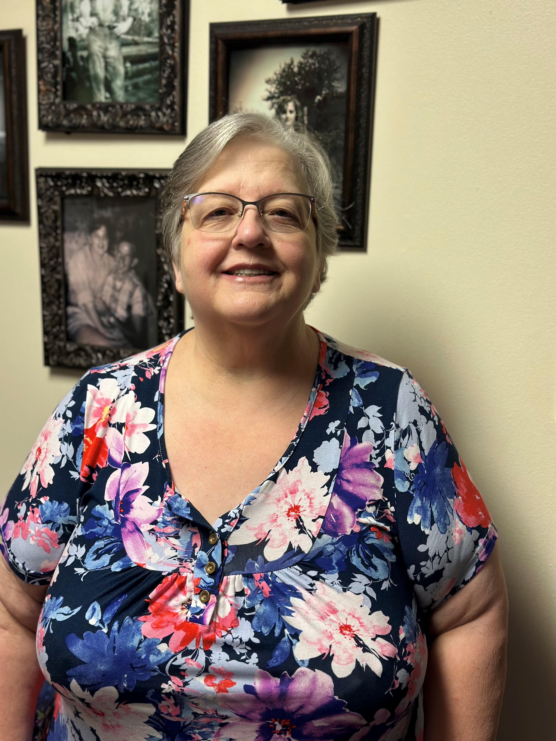
September 2023
Tammy Sauls MSN, APRN, FNP-BC, DNP
I am a family nurse practitioner in a mental health clinic. I treat the medical needs of patients that have psychiatric, and substance use disorders. My clinic has patients from Fayette, Mercer, Raleigh and Summers Counties. I have been in the medical field for forty-four years, starting at the hospital as a ward clerk and eventually as a RN and then a NP. I have worked with patients who have chronic medical conditions and substance use disorders for years. I have seen how SUD affects my patients and leaves them without any support, emotionally and financially. Many of my patients are homeless, so treating them is challenging because they leave the area and then return wanting treatment again.
Working with the West Virginia Hepatitis Academic Mentoring Partnership has been wonderful. They are so helpful, and knowledgeable which has allowed me to educate my patients about hepatitis. I have had sixteen submitted consultations with three cures so far. This program has been beneficial for the patients in my area because of the limited number of providers in the area treating hepatitis.
I have encouraged other colleagues to work with the WVHAMP program because the need is so great in our area.

Slide 15
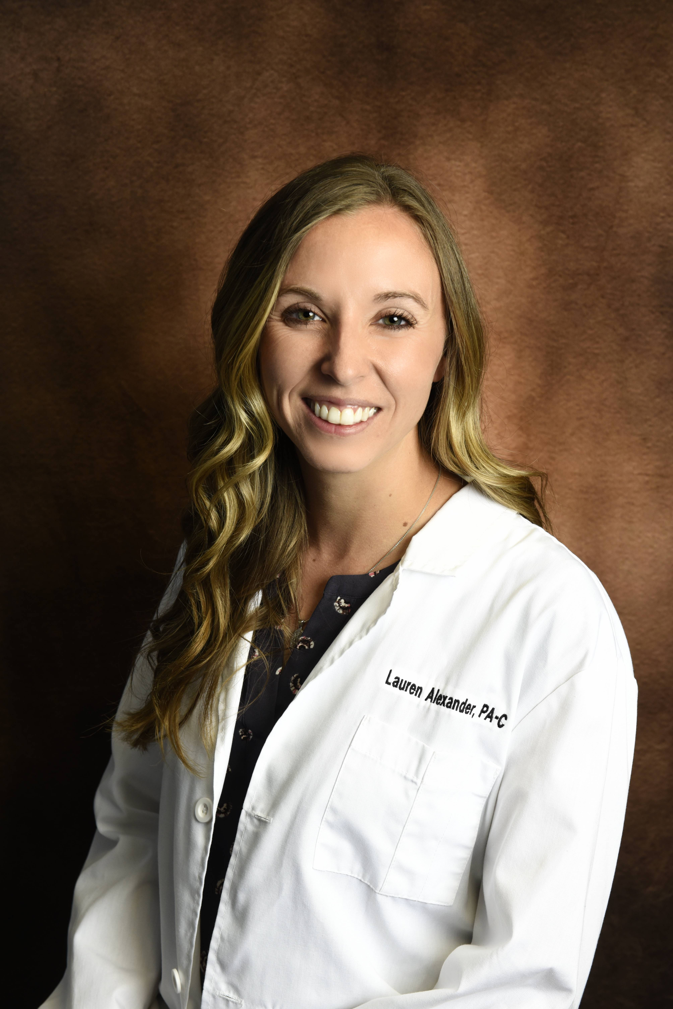
November 2023
Lauren Alexander, PA-C
Ever since graduation from Physician Assistant school in 2016, I knew that Family Medicine was my passion. Developing relationships with my patients and being there for them through their hardships and their triumphs makes Family Medicine more than just a job to me. When I first became interested in treating Hepatitis C and attended a lecture on this topic in 2019, I remember feeling disappointed with how seemingly inaccessible and difficult the process was to help patients become cured of this disease.
In 2021, I completed the West Virginia Hepatitis Academic Monitoring Partnership initial training. With the assistance of this program and the faculty who continually offer their support and guidance throughout the process, I have been able to successfully treat and cure 14 patients of Hepatitis C, with another 4 patients awaiting SVR12. Seeing the renewal of energy and hope that these patients achieve by being cured of this chronic disease is one of the most rewarding experiences that I have encountered in my career. I look forward to continuing to work with the West Virginia Hepatitis Academic Mentoring Partnership to provide access to treatment and cure for Hepatitis C in our Primary Care clinics.

Slide 16
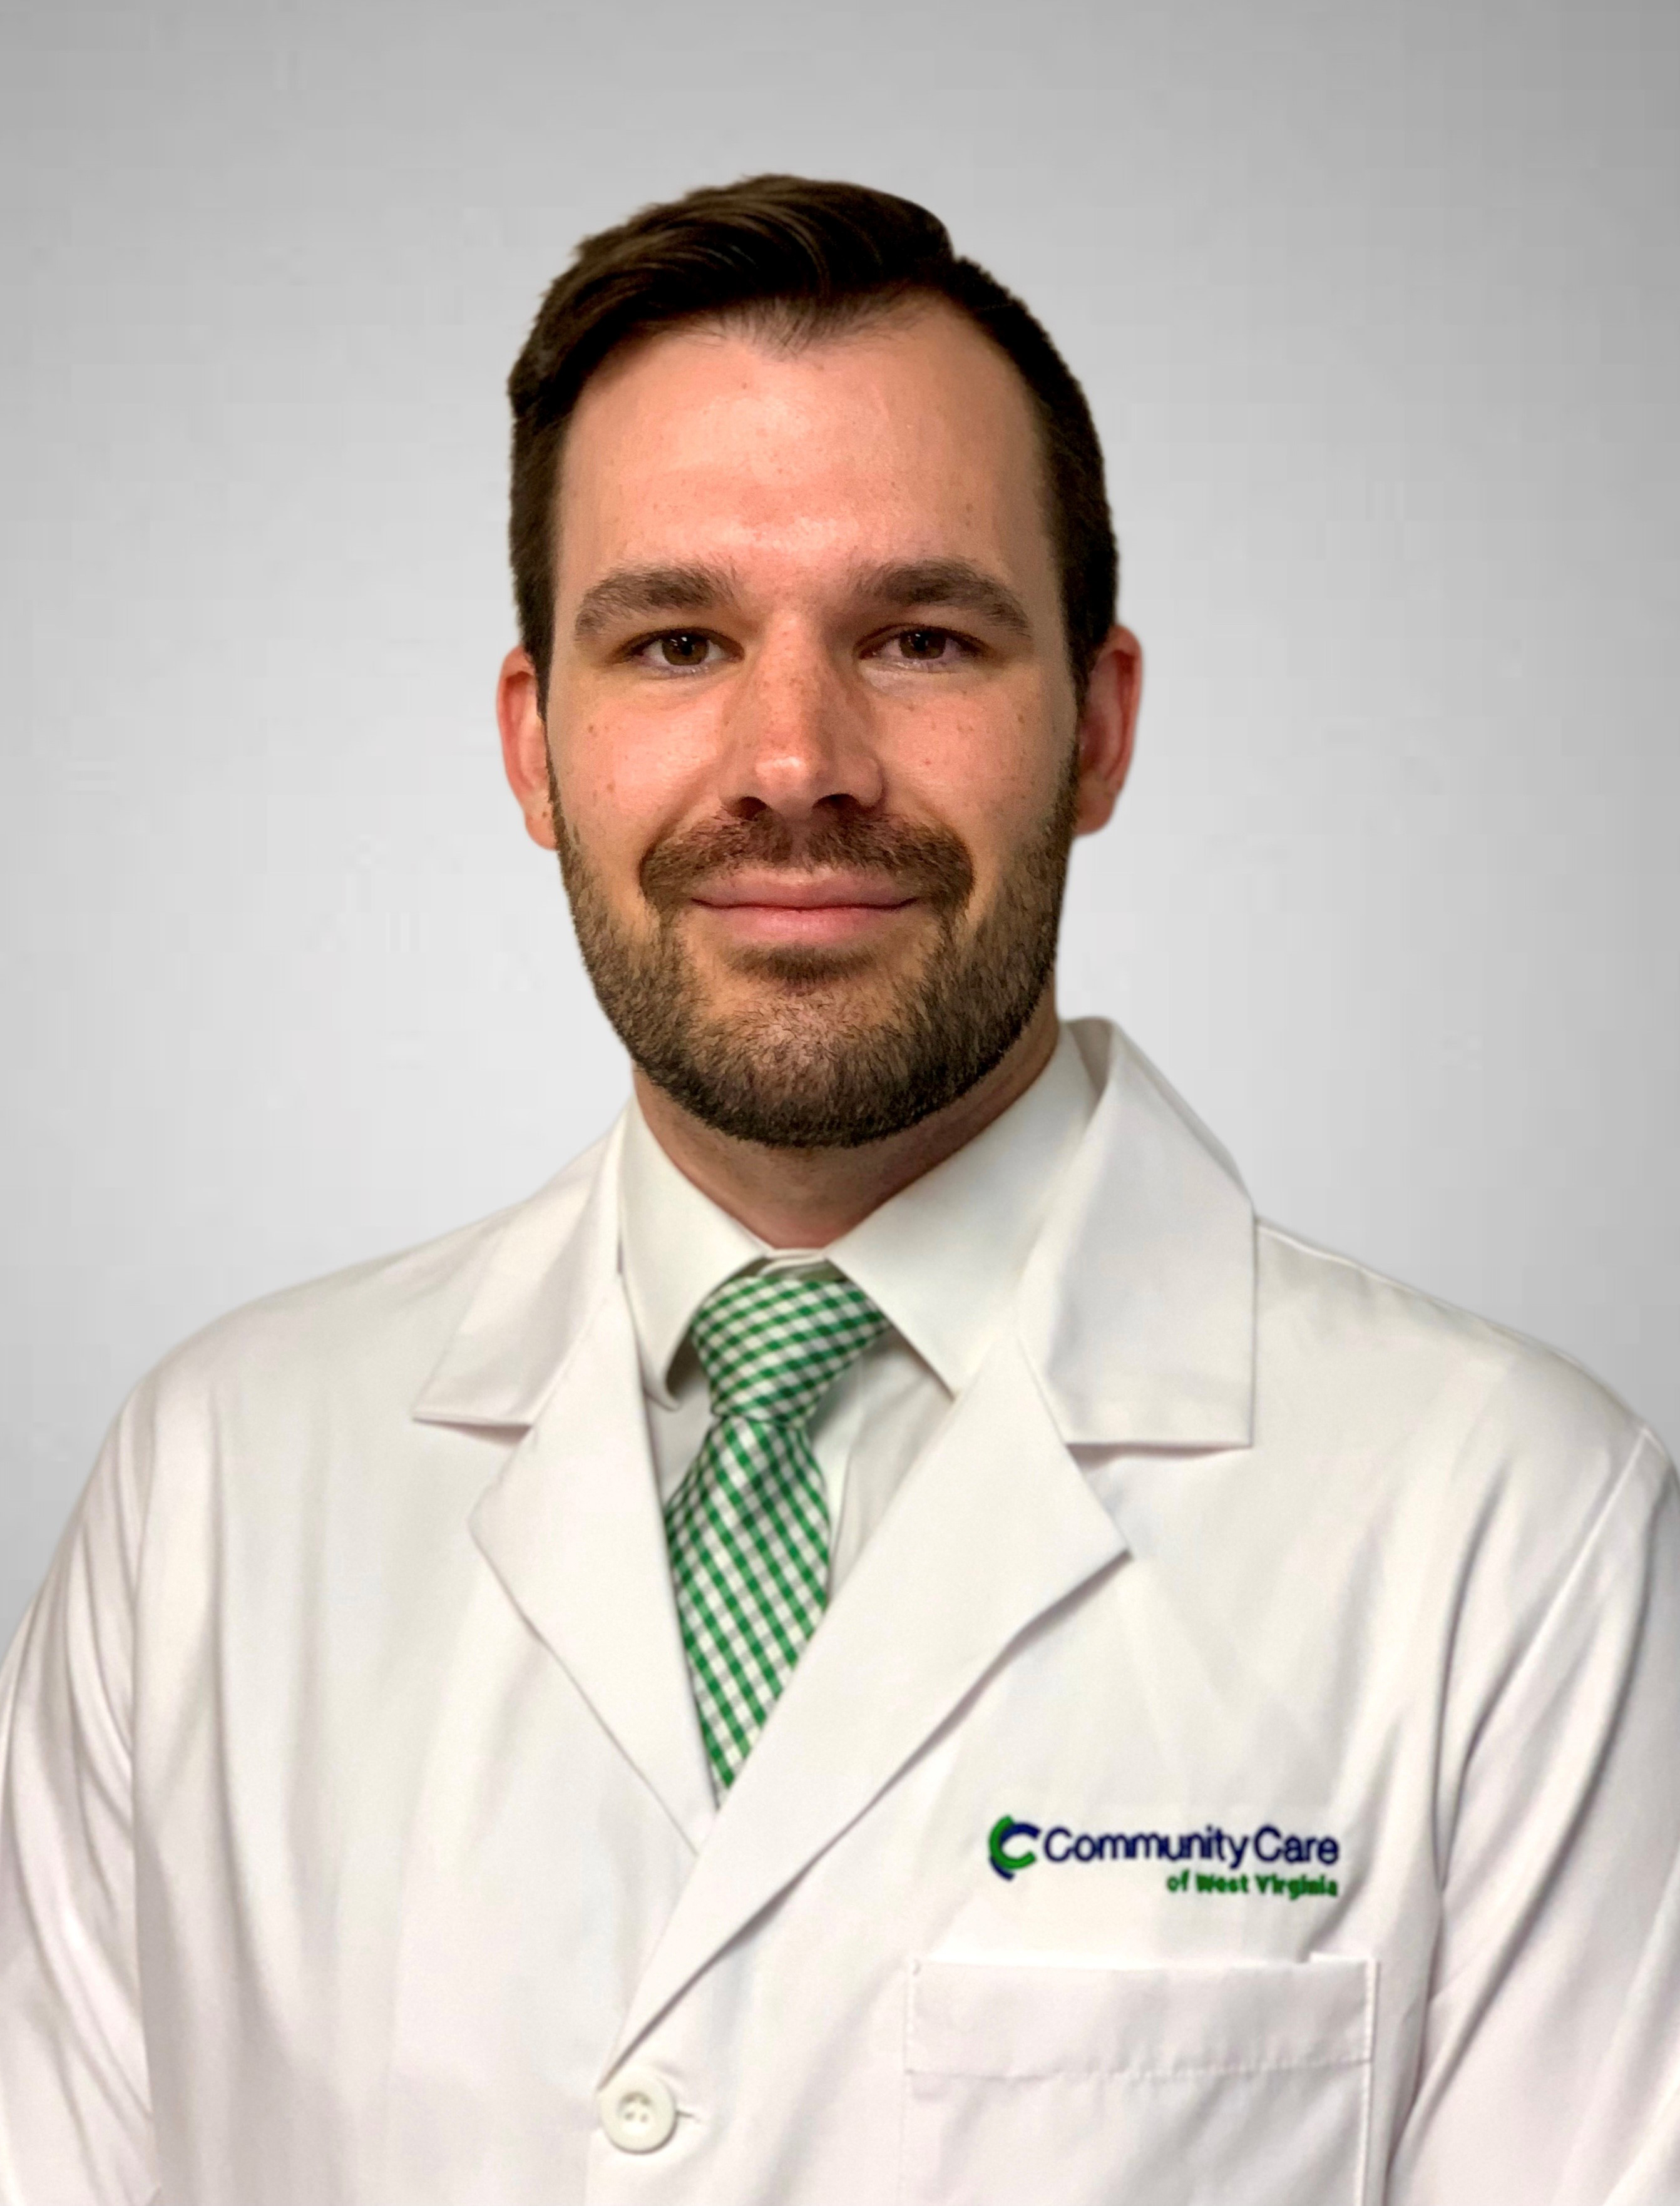
December 2023
Dr. Kyle Miller
As a medical student, I was torn between specialties for some time. The decision seemed daunting – to make a choice of one type of medicine to make a career out of. I was edging towards becoming an ophthalmologist until I spent time on my family medicine rotation, where one of my mentors relayed something to the effect of “you can be the person who checks blood pressure and cholesterol, or you can be the person who builds a practice that fits you” – which, for me, would mean a practice that involved much more than Lipitor.
Fast-forward from school to my time as an attending, I now practice at an FQHC (Community Care of West Virginia) where the company has graciously enabled me to build a practice that fits me. I practice primary care that includes addiction treatment and am based in a clinic with on-site behavioral health services, which enables a degree of care integration that can be difficult to achieve in an underserved setting. Though integrated care is often interpreted as “primary care and behavioral health”, I’ve personally sought to apply an integrated approach to the care of patients with substance use disorders – aiming to take care of the whole patient, rather than only their SUD. Thus, thanks to WVHAMP, CCWV, and my training at WVU, I now find myself treating SUDs comprehensively – I treat chronic conditions that contribute to relapse, counsel on preventive care, drain abscesses, close lingering wounds, engage in harm reduction principles, and attempt to deal with the other sequela of substance use.
Perhaps the most symbolic is the treatment of hepatitis C. For many patients, especially those who have achieved sustained sobriety, the hepatitis C diagnosis remains a sort of scarlet letter – a badge not reflective of their true self. Helping patients to remove this stigma from their problem list has been one of the most rewarding aspects of my time in practice so far, and I am proud to have over 20 patients in some stage of the treatment process.

Slide 17
February 2024
Dr. Humerick took the WVHAMP training in 2022 and has submitted 15 consults and cured 5 patients of the 6 that have completed treatment so far. Dr. Humerick works with her colleagues at WVU Rural Family Medicine Residency to mentor the resident physicians in treating Hepatitis C in clinic and as part of their street medicine program/rotation. She has successfully treated patients with housing insecurity and those with active substance use that are actively participating in the local harm reduction program at Berkeley County Health Department. Learning a new, practicing changing skill has been rewarding for her as a physician and also part of a patient centered approach to medicine. Dr, Humerick has seen that patients appreciate the one stop shop of treating their Hepatitis C while addressing acute and chronic primary care issues.

